Slide 1
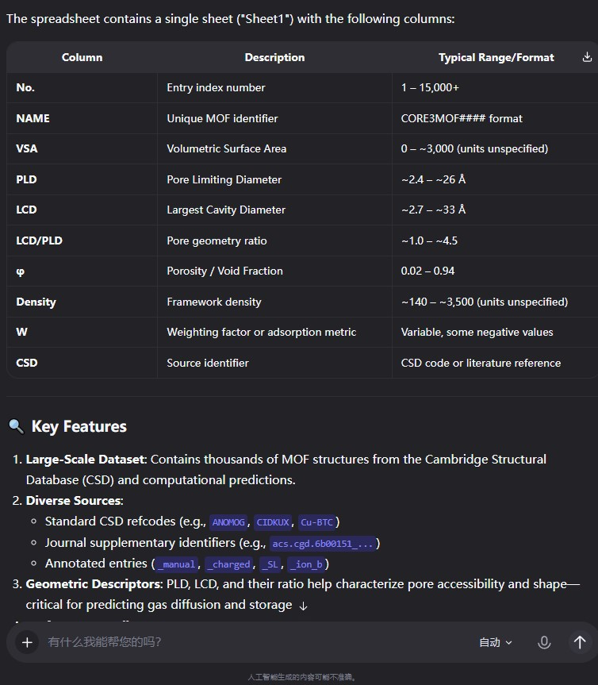
Data recognition error
Hallucination

Slide 2
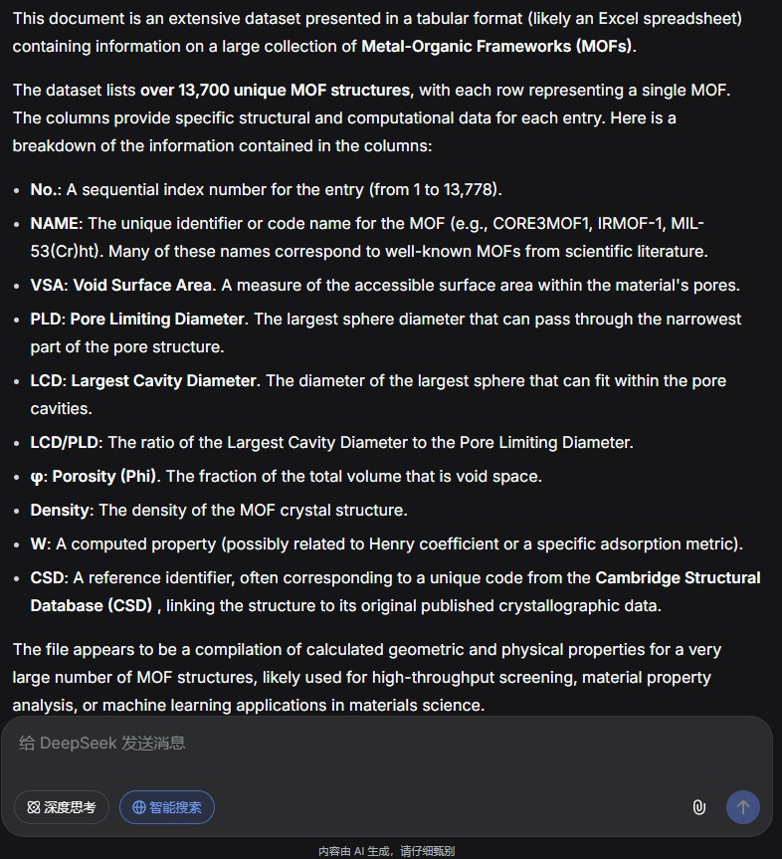
In fact, there are 15333 entries.
Hallucination
Error: Actually, it is capacity.

Slide 3
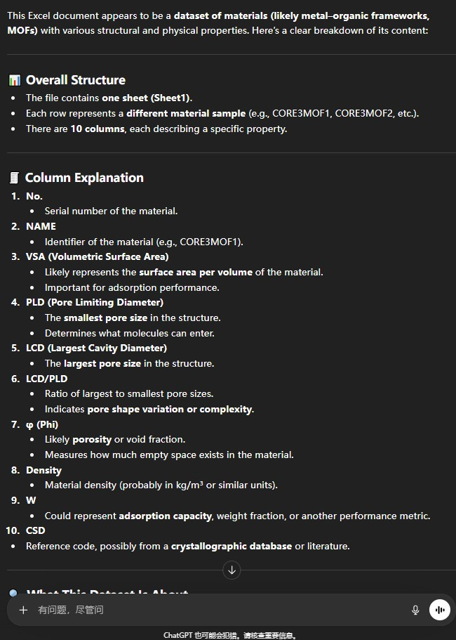
Error: Actually, it is Cambridge Structural Database.

Slide 4
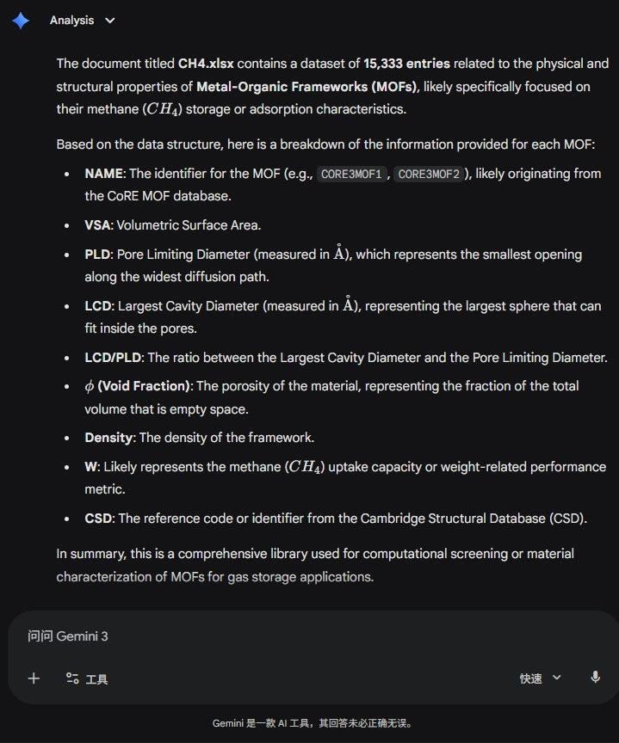
Incorrect inference

